Slide 1
The ASL Dept @
Mintlaw Academy

Slide 2
What is ASL ?
ASL Stands for : Additional Support in Learning.
Lots of people need something in place to help them learn and work.
This support may be for always or it may be for a short time.
There is nothing wrong with getting help from the ASL Dept.
We work with all the other school staff to help you be the best you can be.

Slide 3
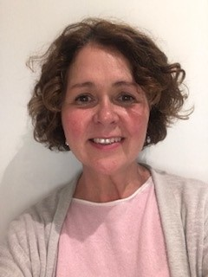
Who we are.
I am Mrs Fraser and I am the Principal teacher of the ASL department at Mintlaw Academy.
The ASL team are a mixture of teachers and PSA staff but we all work together to support pupils across the school.
My office and our class rooms are in B corridors but we help in all classes in all departments too.

Slide 4
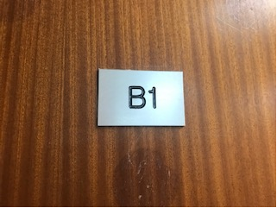
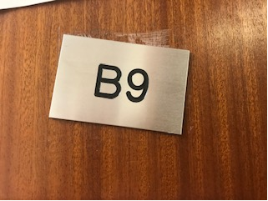
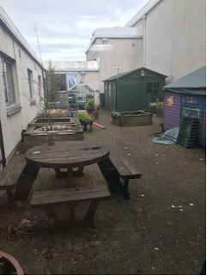
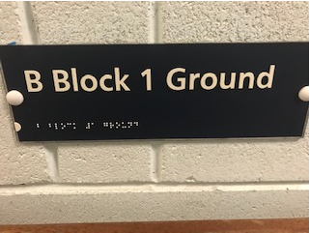
The enhanced learning suite has some smaller classes, a quiet room and a courtyard. Some pupils will come to these classes for Maths and English.
Enhanced Learning Suite.

Slide 5
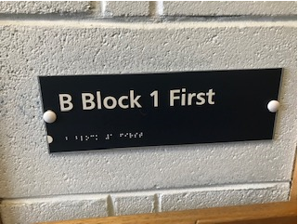
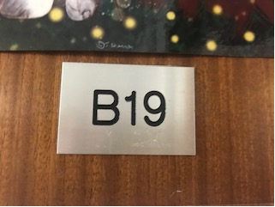
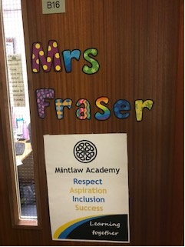
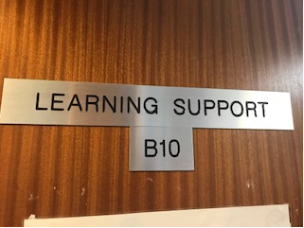
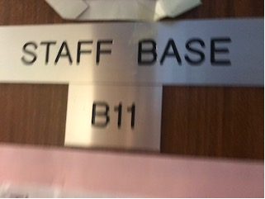
Other ASL Classes
Upstairs we have some other ASL classes and rooms that you may attend during your years at Mintlaw Academy.

Slide 6
Break & Lunch club
Sometimes you may need a quiet space at break or lunch.
B1 is a place you can come to sit and have your break or lunch with other pupils who also need a quiet space.
You would not come here with your friends group but would come if you were on your own.
You can sit and chat with the others there or just sit quietly if you wanted to.
PSA staff and teaching staff watch over the group .
We meet in B1 on the ground floor.

Slide 7
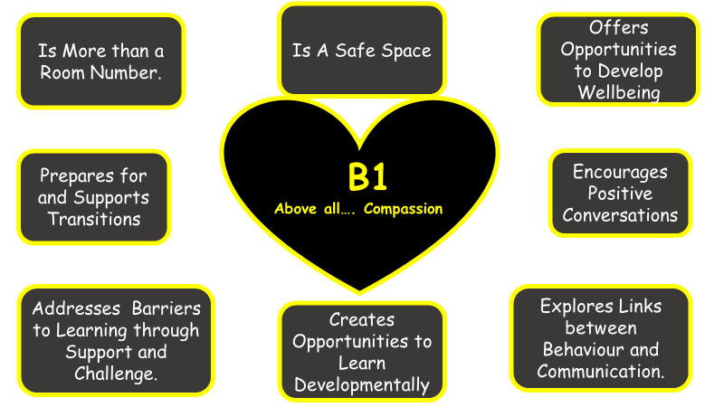
B1
B1 is a very special part of our school. It is safe place where all pupils can get support, quiet time and conversations when they need it. Your guidance teacher will ask you to come to B1 sometimes if they feel it would help you.

Slide 8
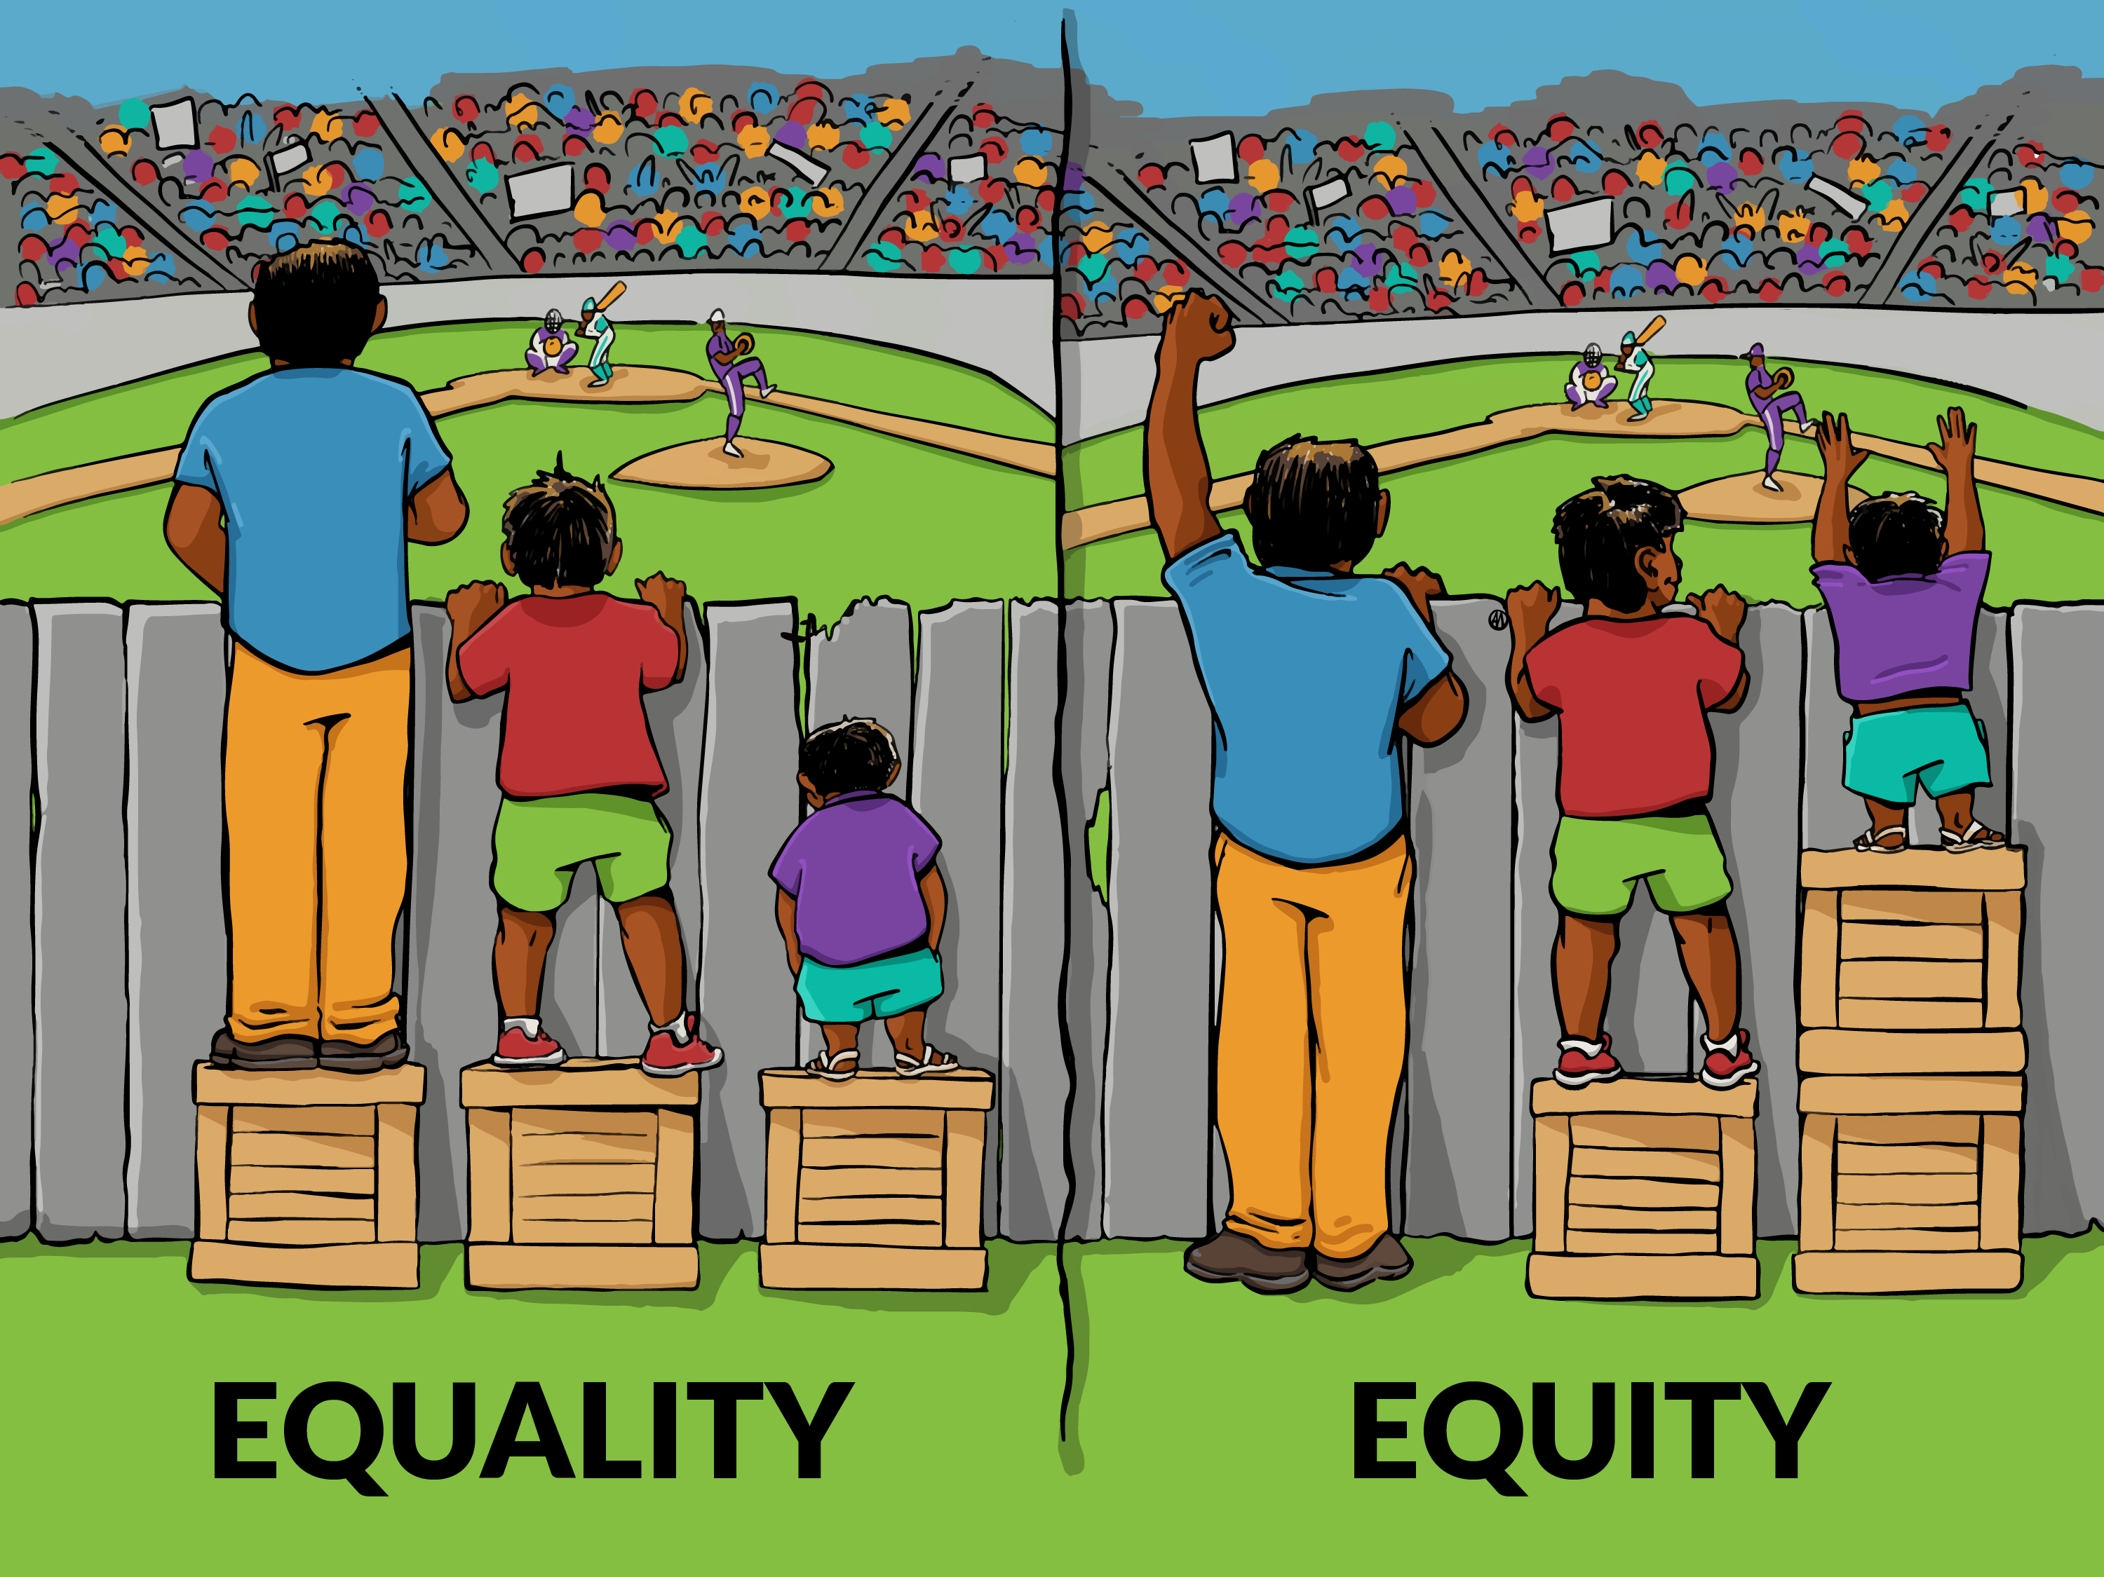
AAA: Additional Assessment Arrangements
My team and I will work with you, your parents, carers and teachers to make sure you get the right support for doing assessments and exams.
We may do some testing with you to find out what support you need -if any.
Not everyone will get AAA and not everyone will want to use them.
AAAs are to make sure that assessments are kept fair for everyone.
Using digital and Read and Write Gold
Getting a reader or a scribe
Using a spell checker
Using coloured papers or overlays
Getting extra time

Slide 9
The ASL team look forward to getting to know you and helping you at Mintlaw Academy.
Respect Aspiration Inclusion Success

