Slide 1


Numeracy
Having fun with number in P1

Slide 2
We all use maths every day!
Take a moment to think about your day- how many different things have you done today using number or maths?

Slide 3
Here are just a few!
Use a calendar/ diary
Plan a journey
Look at a clock/ watch
Wrap a parcel
Divide up a pizza or cake
In a parking meter
Compare prices
Add postage and packaging
Set the Sky recorder
Check TV programme times
Read a map
Follow a recipe
Write a cheque
Write a shopping list
Check your change in a shop
Set the microwave
Measure up for curtains/ carpets
Weigh yourself
The list goes on!

Slide 4
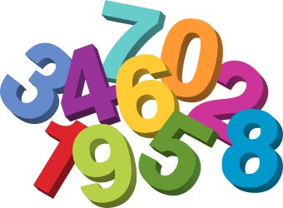
So………What will we learn in P1?
Counting to 10 (and beyond!)
Making sets of numbers
Counting on and back
Finding numbers more than/ less than
Adding on
Taking away
Looking at patterns
Telling the time
Using money
Measuring- length and volume
Weighing
Investigating shapes- 2D and 3D
Solving problems
Data handling- gathering, sorting, displaying
Fractions- wholes, halves and quarters
Symmetry
Days of the week, Months of the year, Seasons……………………

Slide 5
But just like reading and writing, we need to learn a special code to help us master number!
So…….let’s learn to count to five!
Are you ready?
1 2 3 4 5

Slide 6


Slide 7


Slide 8


Slide 9


Slide 10


Slide 11
Now we know our numbers, let’s see if you can work these out- no peeping back!
after
before
and
take away

Slide 12
What children learn at the Early Level lays the foundations for what follows.
Children will have many fun opportunities to learn the various numeracy skills in school. We will have to practise these skills so that, like reading and writing, they become automatic.

Slide 13
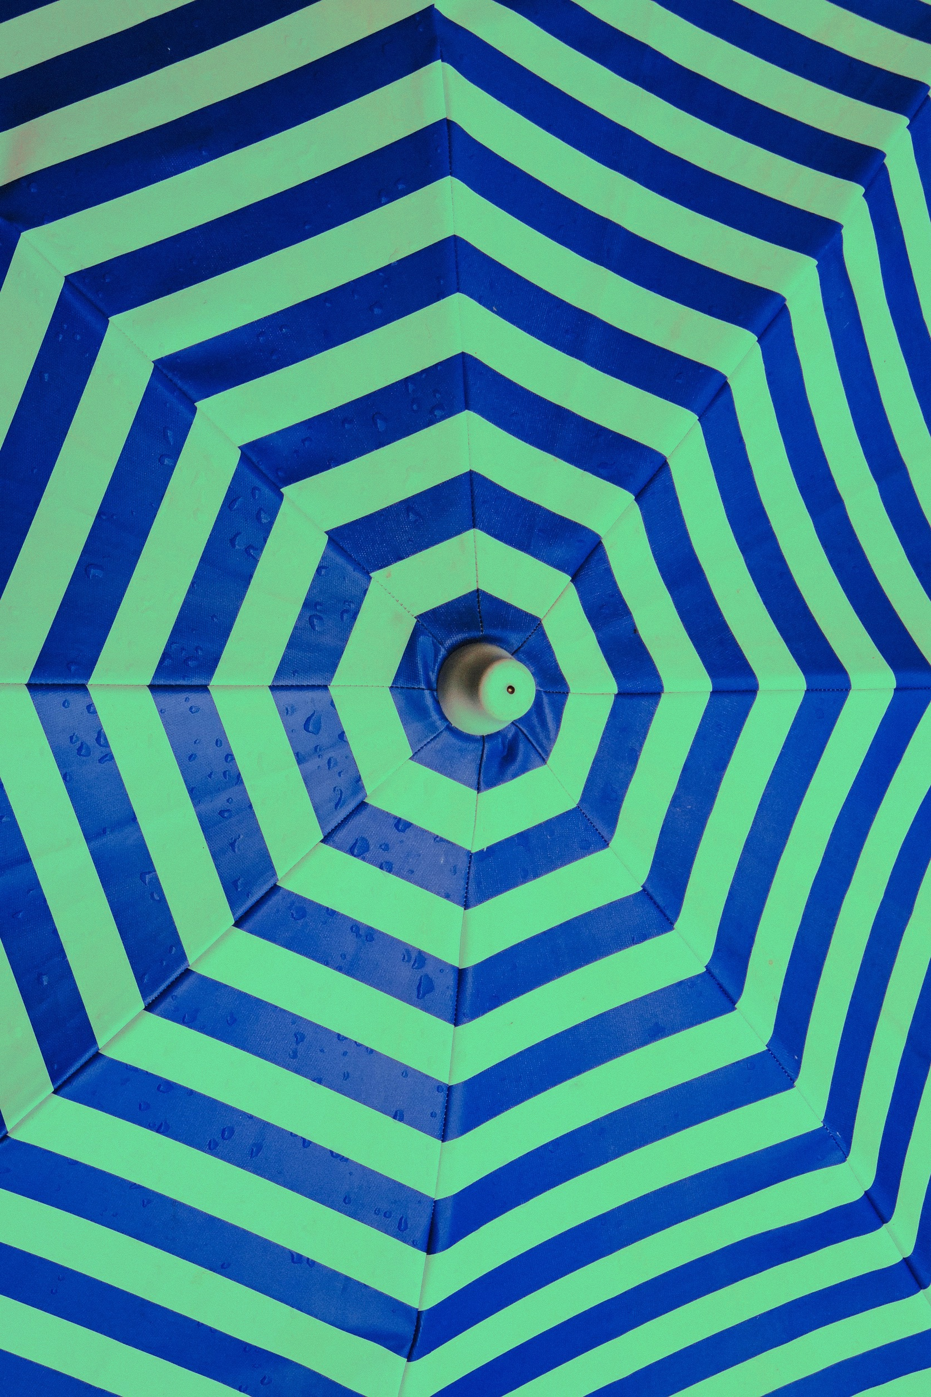
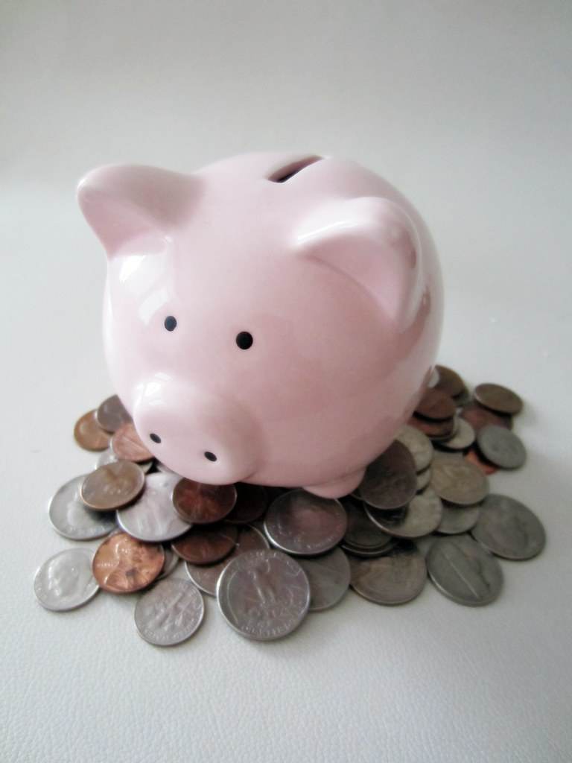
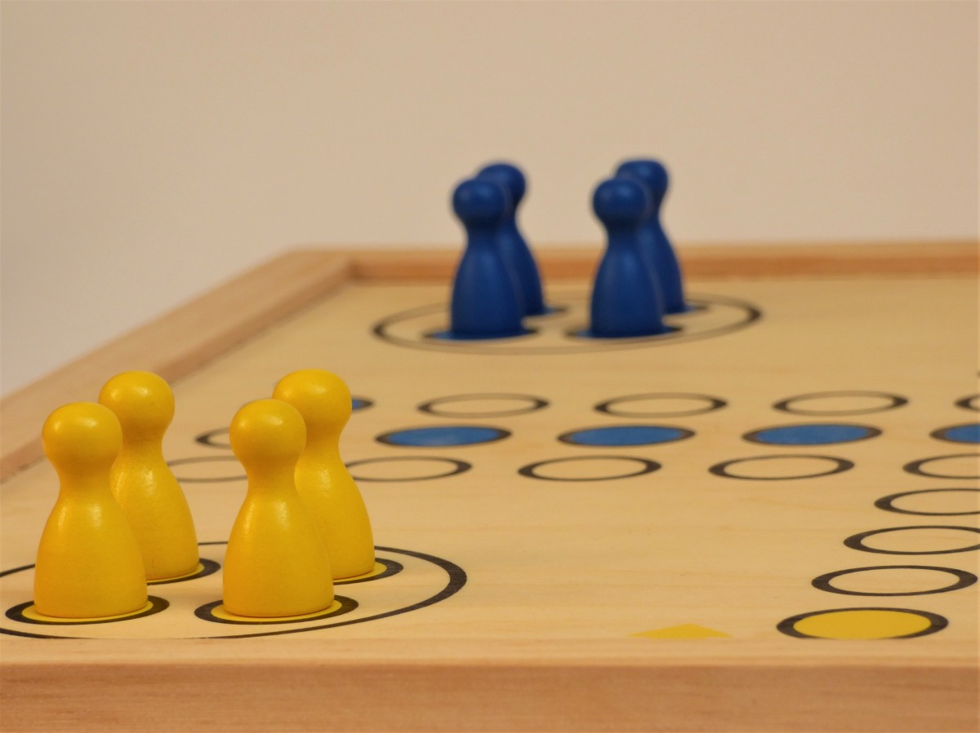
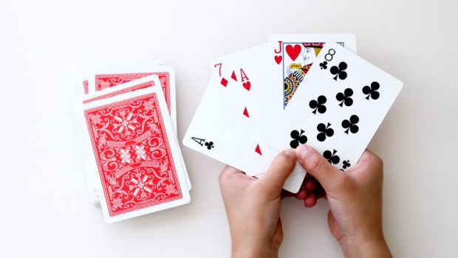
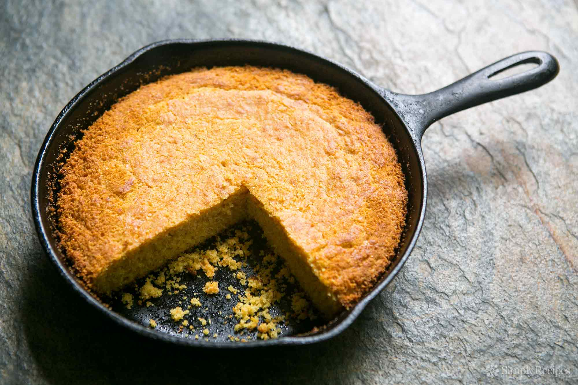
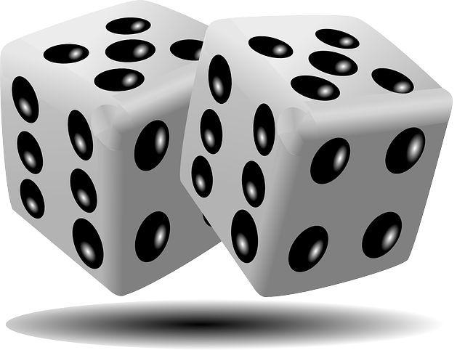
Ways you can help to develop numeracy skills at home
Play card games for number recognition- Snap! Pairs, Higher or Lower, Pick 2 cards and add them together- the higher/ lower number total wins!
Dice games- roll 2 dice, add the numbers and park your car in the correct parking space
Dominoes- turn them all over, pick a domino each- the person with more spots wins that domino!
Find numbers as you walk to school- on doors, road signs, car number plates…. See who can find e.g. 8 first!
Play with real coins- sorting them, “buying” things as you play together, First to find…..a 5p coin!
Bake- weigh out the ingredients
Can they find the numbers on the TV controller to watch a programme?
Go shopping together- make a list for them to find some things e.g. 5 oranges, 6 bananas, 4 yoghurts….
Make patterns as you play- red car, blue car, red car….; leaf, leaf, stone, leaf, leaf, stone; big ted, little ted, doll, big ted, little ted, doll……
Looking for shapes in and around the house/ garden
At the swing park- who is heavier on the seesaw?
Treasure hunt- find, 6 twigs, 3 feathers, a square…
Have a board games evening every week- Snakes and Ladders, Uno……

Slide 14


