Slide 1


Emerging Literacy
Early Reading, Writing, Listening and Talking
How can you support your child as they develop their reading, writing, listening and talking skills?

Slide 2
Let’s start with an easy task…….

Slide 3
Was that an easy task?
What did you have to be able to do in order to write down my sentence?
What knowledge did you need?
Which skills did you need?
Were there other things you needed?

Slide 4
In Primary 1 we will be developing your child’s literacy skills in the following 4 areas-
Concepts of Print
Phonological Awareness
Oral Language
Fine Motor Skills

Slide 5
It is easy if….
Many different skills
Co-ordinated
In the right order
Automated

Slide 6
Automated?
If you drive…….
Think back to what it was like the first time you drove a car!
How is that different to now?

Slide 7
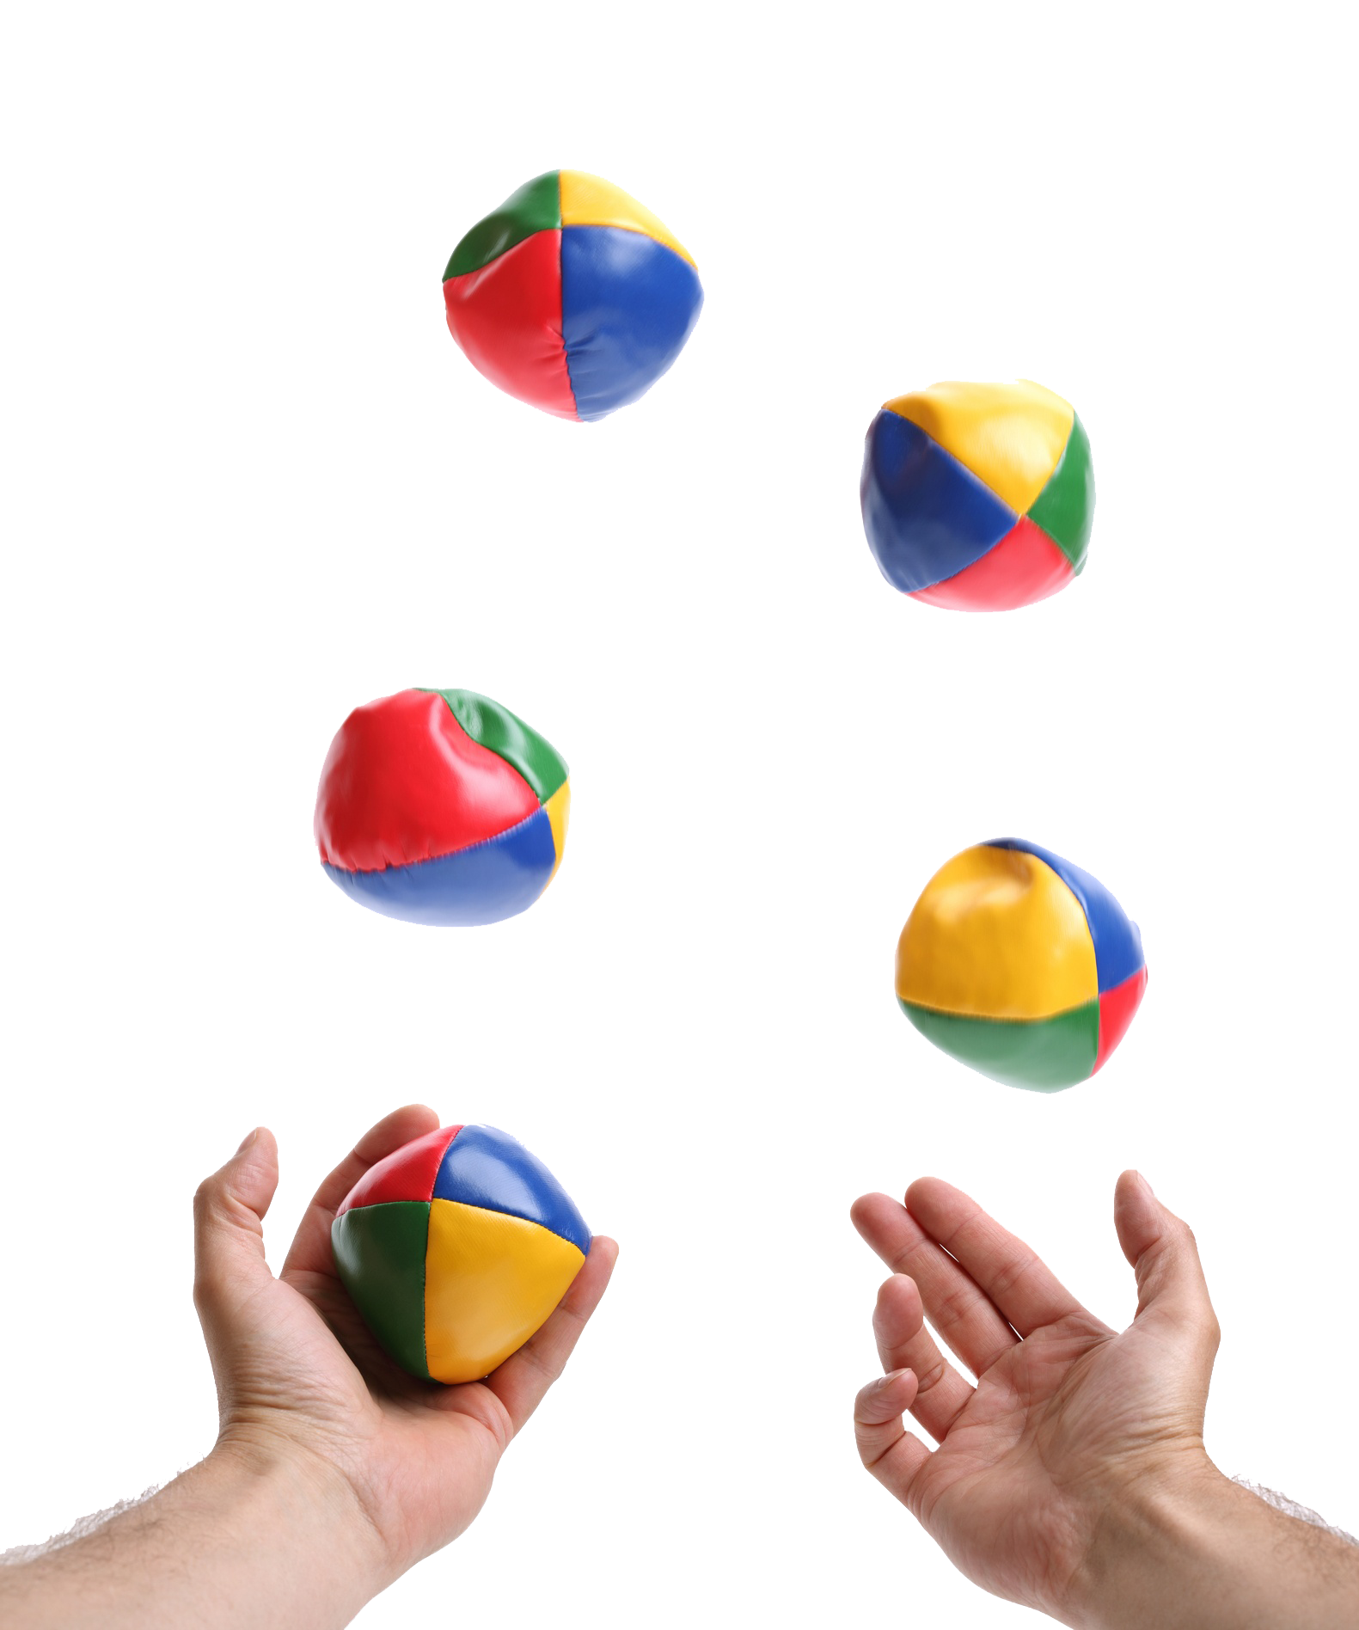
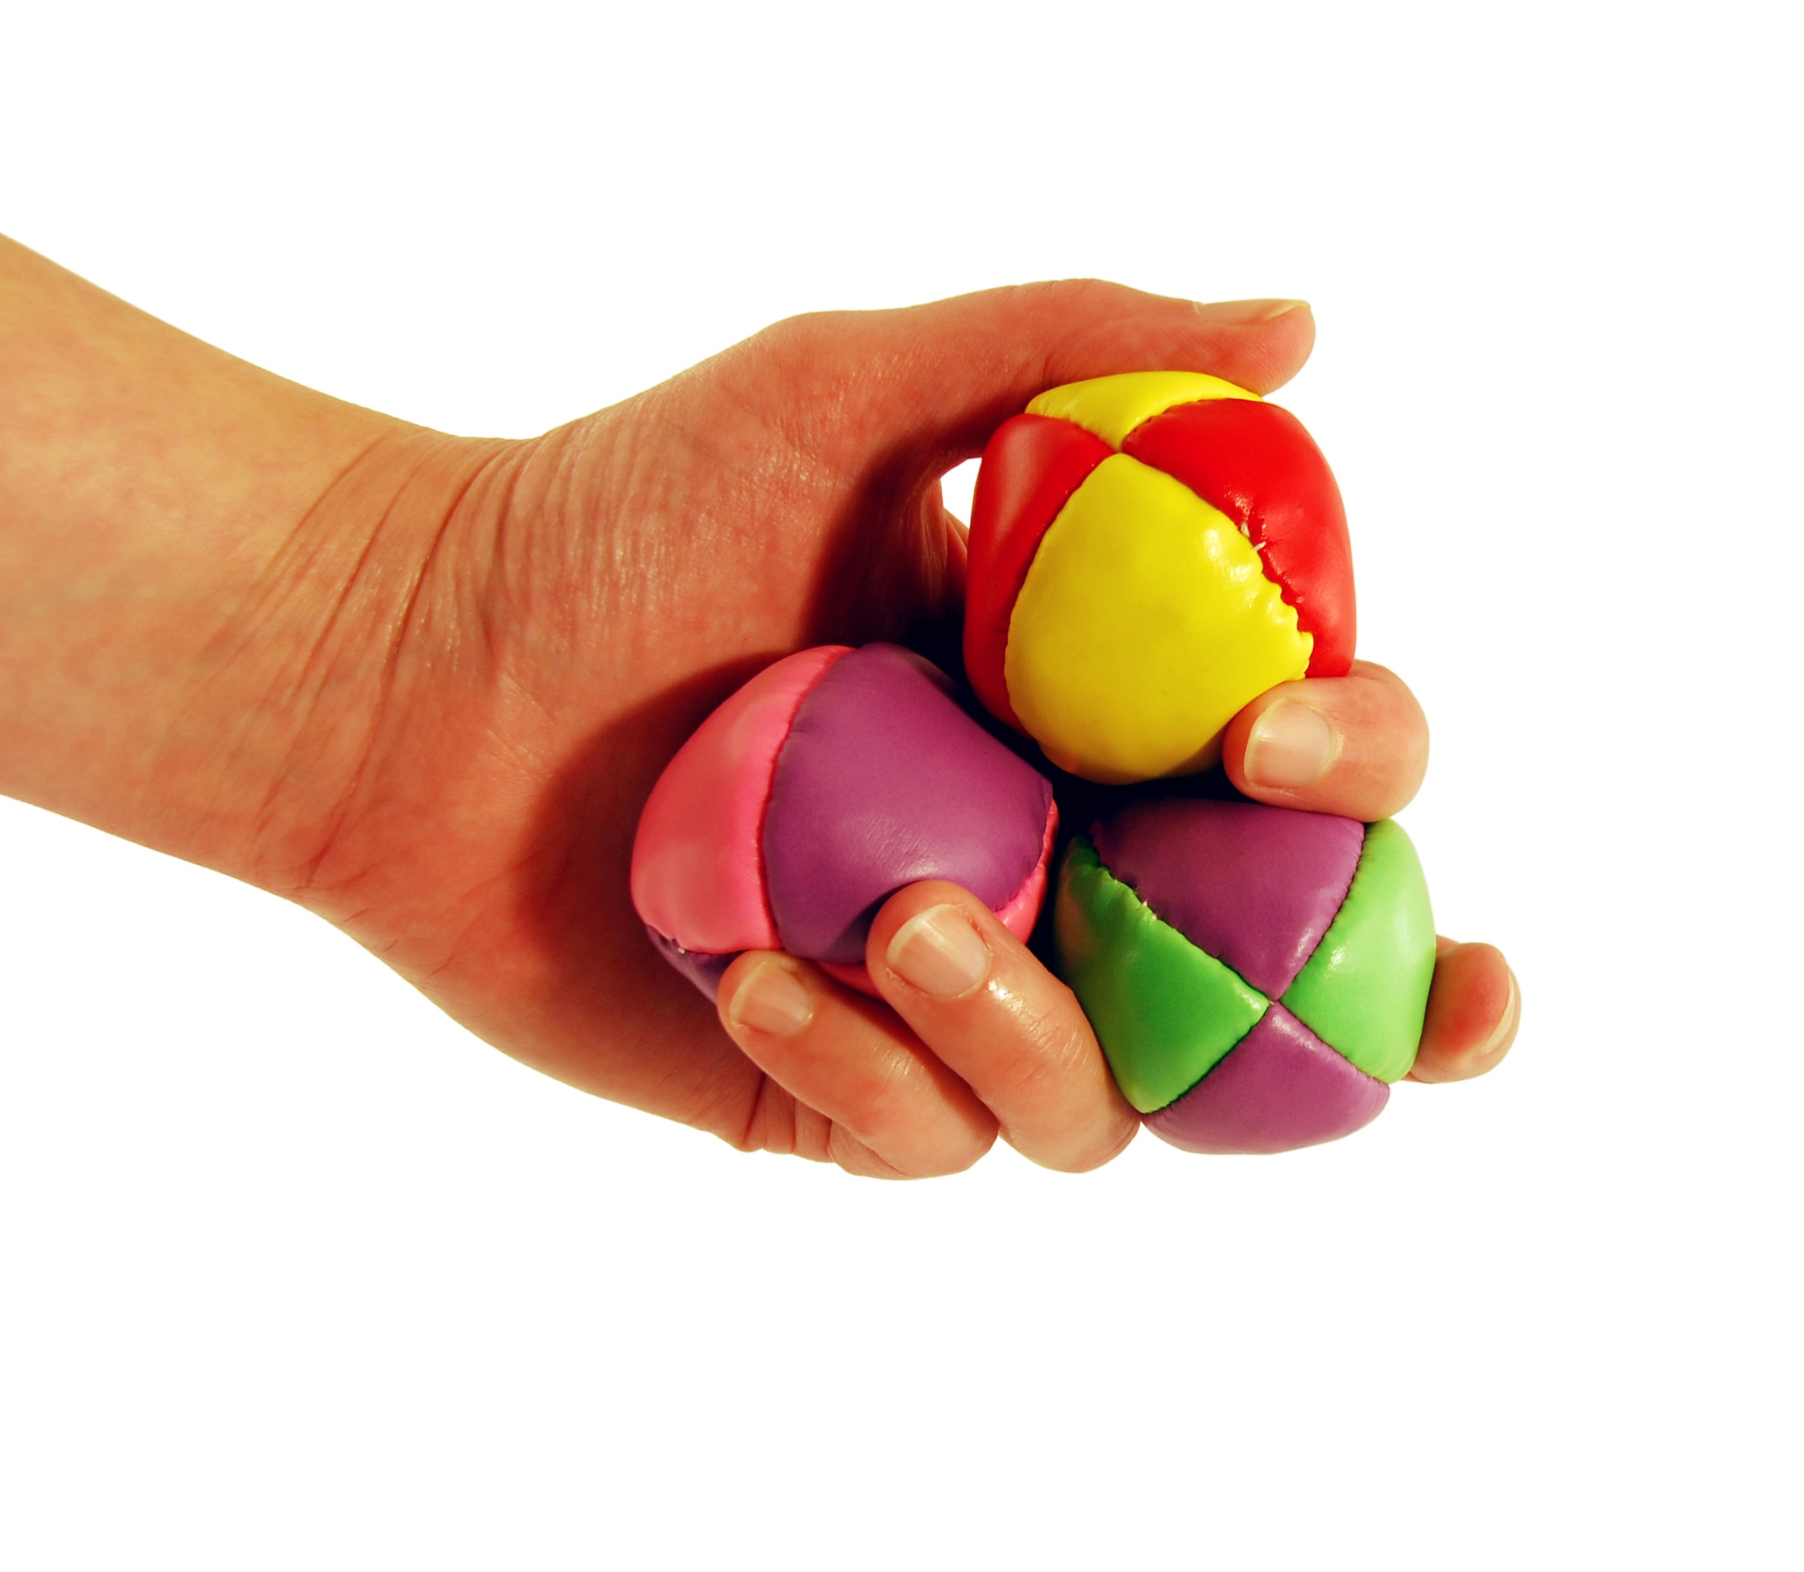
Co-ordinated?

Slide 8
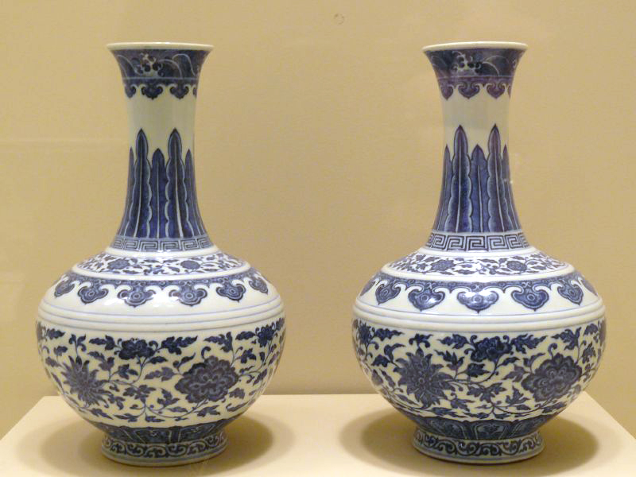
But……what if I gave you these to juggle?

Slide 9
Automated skills
To learn any new skill, be it learning to drive,juggle balls or learning to read and write….....
Takes practice for skills to become automatic
Effortless
Does not use “capacity”- room to think about other things
Think of a child who wants to write the sentence I gave you at the beginning of this powerpoint. We need them to be able to think effortlessly to do this-
Holding a pencil
Spacing
Writing from left to right
Where one word ends or another begins

Slide 10
Is it similar for reading?

Slide 11
As adults, we have learned the skills needed to read.
But let’s try forgetting how to read……..
Not as easy as it seems!
Mo st pe ople c an rea d t h is.
No rdo est hisg ive ma nypr obl ems.
Xvxn xf yxx txkx xxt lxttxrs.

Slide 12
Now try reading this!
&%* &~#£ #$ *ou &~#nk
%>ad#ng #£ >a£*

Slide 13
ithinklearningtoreadneedsustolearnlotsofnewskillsthink
howdifficultlearningalltheseskillsmustbeforyourchild

Slide 14
So…….how can you help your child master all the skills they need to read, write, listen and talk?

Slide 15
Phonological Awareness
Children need to develop phonological awareness skills to help them read and spell.
It focuses on developing a number of skills where your child will be encouraged to-
Listen to and follow instructions
Hear and produce rhyme
Become aware of syllables within words
Identify sounds within words.

Slide 16

Phonological Awareness-
Ways you can help at home
Sharing nursery rhymes
Reading rhyming books e.g. The Gruffalo, Hairy MacLary, Room on the Broom
Making up rhymes together e.g. Humpty Dumpty drove a fast car, Humpty Dumpty got stuck in the tar! All the King’s horses and all the King’s men, Pushed him until he was free again!
Supporting your child to create their own rhyming words (even nonsense words!) e.g. I spy with my little eye something that rhymes with bar- car, jar, star, lar, var…..
Talk like a robot! E.g. Can you guess my word?- com-pu-ter= computer; butt-er-fly= butterfly. Now get your child to be the robot for you to guess the word!
Odd one out- place 3 objects in front of your child e.g. banana, boat, sock. Say each word- which one is the out one out?- sock- the other 2 start with b

Slide 17




Concept of Print
Reading with your child for 10 minutes each day will have a positive impact on their awareness of print. You may read lots of different stories or you may read their favourite story again and again!
When reading with you child-
Turn off your phone/ TV/ipad etc
Find a quiet space
Sit beside them
Let them see the pages and point out the pictures and words.
Talk together about what you see in the pictures- the pictures will help tell the story
Have fun!
When you are out and about, point out food labels, road signs, shop signs, words on shopping bags.....
Why not become a member of the local library- it's free! This way, your child can enjoy LOTS of new stories!

Slide 18

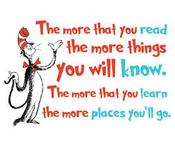

Slide 19
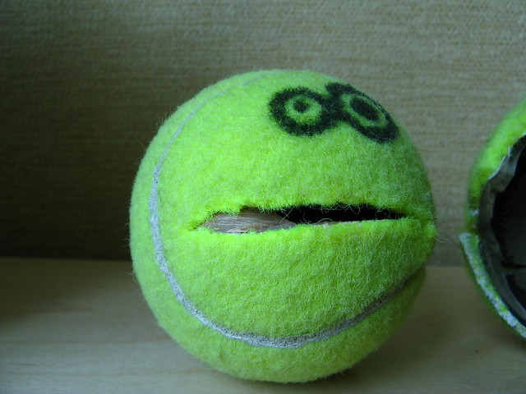

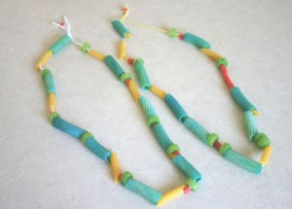
Fine Motor Skills
Fine motor skills are the skills we need to carry out everyday activities that require controlled and precise movements e.g. doing up zips and buttons, using a knife and fork, cutting with scissors and writing.
Children will learn and develop these skills through LOTS of practise!
Ways to help at home-
You may find it useful to have toys and activities handy in a plastic box- they are then ready to take out and use when ready to play. Smaller items can be stored in small plastic jars/ boxes/ pencil cases- you could use this as a chance to practise screwing lids, opening containers and doing up zips. Here are some ideas for your play box-
Building blocks e.g. Duplo, Lego
Large and small threading beads or hollow pasta
Popping bubble wrap
Playdough- with forks to make patterns, knives to cut- make a play dough “meal” to cut up using a real knife and fork
Tennis ball with a hole cut into it to make a mouth! See what you can pick up by squeezing the mouth!
Tweezers or small tongs to pick up pasta, pompoms, buttons….
Coins to feed into a piggy bank
Wind-up toys; lids to screw onto bottles/ jars
Card games- snap! Matching pairs
Water spray bottle and milk bottle lids to fire at in the bath!

Slide 20
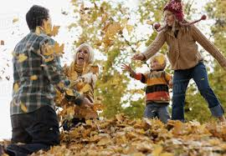
Oral Language
Playing alongside your child for 10 minutes a day will support the development of your child's oral language.
When you are playing with your child here are some of the things you can do to ensure that they have your full attention are-
Play beside them
Give them eye contact
Turn off your phone/ ipad/ TV/ computer
Find a quiet space
Allow them to finish before you talk
Show that you are interested by smiling and nodding
By making sure all these things are in place you will support your child's language through allowing them to hear and use familiar and new words as you play together inside and out!

Slide 21


